Slide 1
Verification of 4 Bit Binary Counter
Presented By: Nuzhat Fairooz Rity

Slide 2
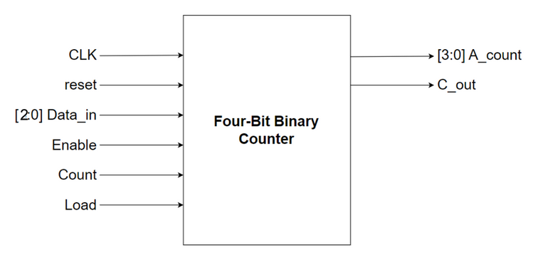
Testbench Flow
The Top Module of a Four-bit binary counter is given above.

Slide 3
Signal Lists
Signals | Bit Width | Description
CLK | 1 | Input Clock Frequency 50~100MHz.
reset | 1 | Input control signal. Active Low synchronous reset signal which resets the circuit when reset = 0.
Enable | 1 | Input control signal. It works as Chip Enable. Enable = 0, The circuit keeps its current state of A_count and C_out. Enable = 1, data loading, up-counting, and down-counting operations will work.
Load | 1 | Input control signal. It is used to load data_in in the circuit. Load = 0, The circuit keeps its current state. Load = 1, then load Data_in data into the circuit.

Slide 4
Signal Lists (cont.)
Signals | Bit Width | Description
Data_in | 3 | A 3-bit input data signal.
Count | 1 | Input control signal. Controls the up-counting/down-counting. Count = 0, down-counts the current data, -1 Count = 1, up-counts the current data, +1
A_count | 4 | A 4-bit output data signal.
C_out | 1 | An output data signal. C_out is an output carry signal that indicates whether the counter (A_count) has exceeded its maximum value. C_out = 1: A_count has surpassed its maximum value. C_out = 0: A_count is yet to reach its maximum value.

Slide 5
Test Plan
SI | Test Name | Purpose
1 | reset_test | To check whether the counter is having a reset value in each clock pulse when reset = 0,
2 | up_counting_test | To check whether the counter is counting upwards when count = 1
3 | down_counting_test | To check whether the counter is counting downwards when count=0
4 | load_value_test | To check whether A_count is having a present/static value when load=0 and also taking input from data_in when load=1
5 | enable_pin_test | To check whether the counter is having a current value when enable = 0,
6 | carry_out_test | To check whether c_out has output carry when A_count gets incremented after A_count == 1111
7 | random_test | To check whether the counter passes previous test cases when random input signals are driven and the CLK signal varies at the given frequency range (50~100 MHz)

Slide 6
Testbench Architecture (Block Diagram)
Tb_top
Test
Environment
Interface
Agent
Generator
Trans.
Driver
DUT
Trans
Coverage
Monitor
Trans
Trans
Scoreboard

Slide 7
Testbench Flow
Test case : Tells Generator which operation to perform
Generator : Input stimulus is generated using randomization and sent to Driver
Driver : Generated input stimulus is received and sent to interface
Scoreboard : Receive signal from monitor and compares with expected values
Interface
Monitor : signals received from interface and sent to scoreboard and coverage
Coverage : Receive signals in form of class from Monitor and covergroup is sampled

Slide 8
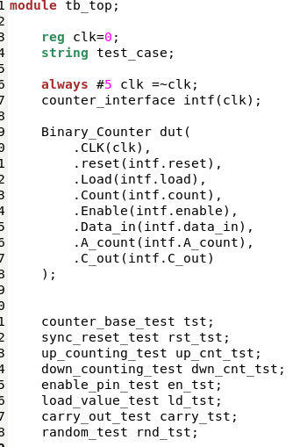
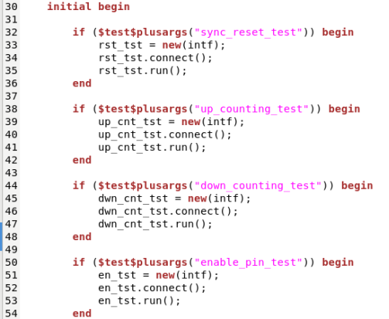
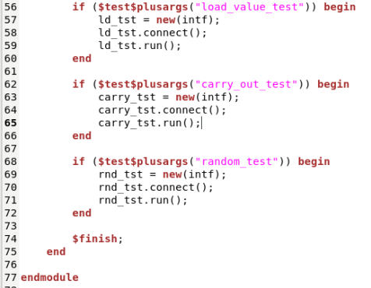
Tb_top
This is the topmost file, which connects the DUT and TestBench. It consists of DUT, Test and interface instances, the interface connects the DUT and TestBench

Slide 9
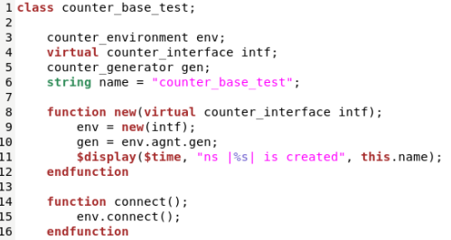
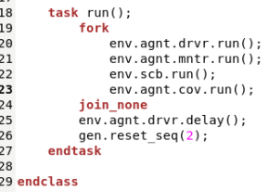
Base Test
Base Test instantiates object of environment class, calls run tasks from different classes (driver, monitor, scoreboard and coverage) to initiate the test.
Different test cases are extended from this class.

Slide 10
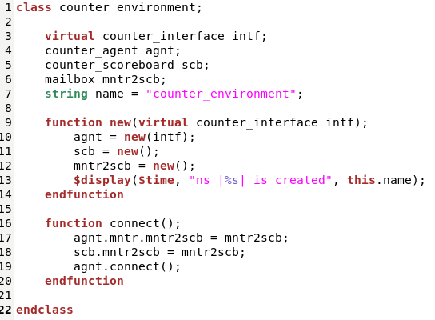
Environment
It it a container class which contains two other classes : agent and scoreboard.
The connection between scoreboard and monitor is done in this class.

Slide 11
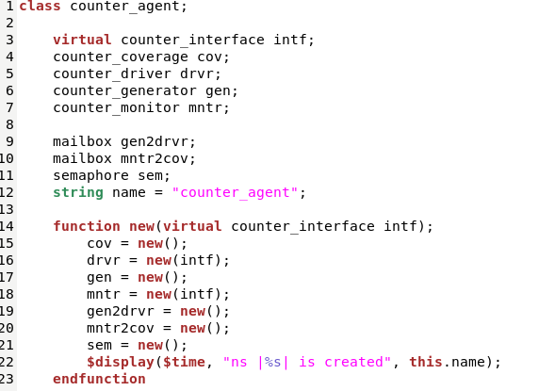
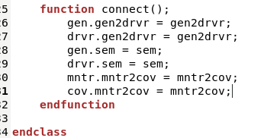
Agent
This class contains other classes (driver, monitor, coverage, generator)

Slide 12
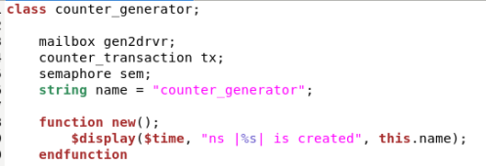
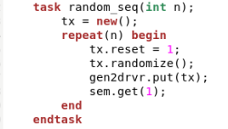
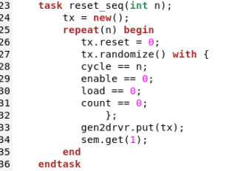
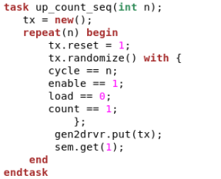
Generator
Generates the stimulus (create and randomize the transaction class) and sends it to Driver

Slide 13
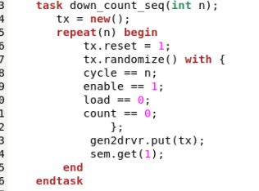
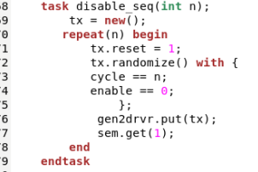
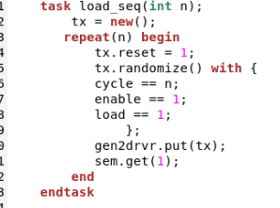
Generator(cont.)

Slide 14
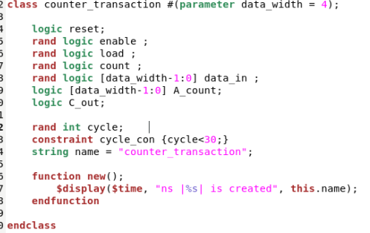
Transaction
The transaction is a container which carries signal values, flags (no of cycle in this case) and other test-related information (for example string test_name) in between different testbench components (Generator to driver, Monitor to Scoreboard, Monitor to Coverage).

Slide 15
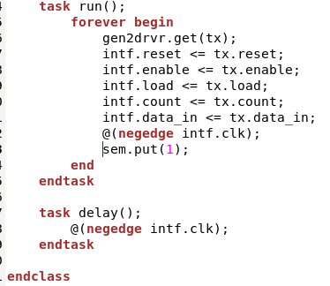
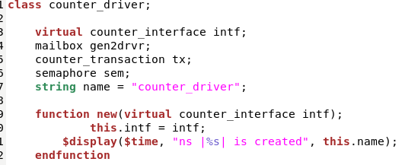
Driver
Receives the stimulus (transaction) from a generator and drives the packet level data inside the transaction into pin level to DUT via Interface.

Slide 16
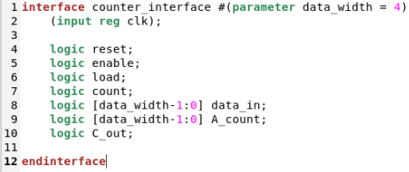
Interface
All signals are grouped together in the interface block, and it’s easier to reuse the signals by calling instances of interface.
The signals can be driven to DUT or vice versa via Interface.

Slide 17
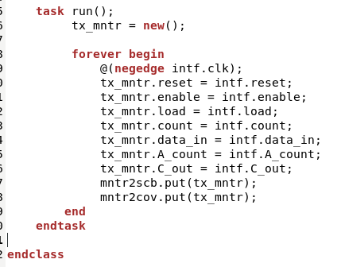
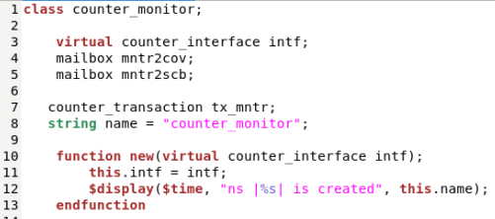
Monitor
Observes pin level activity on interface signals and converts into packet level (transaction) which is sent to the scoreboard and coverage.

Slide 18
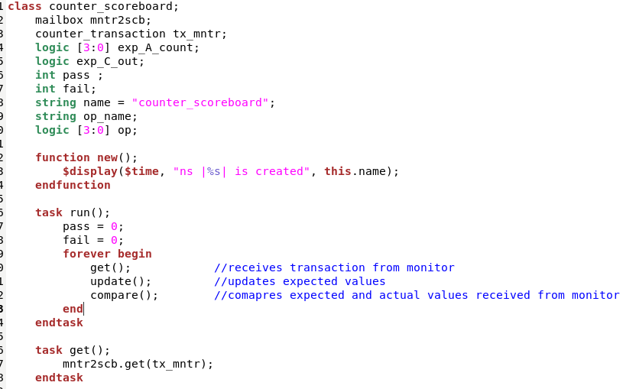
Scoreboard
Receives stimulus (transaction) from Monitor and compares them with the expected values.

Slide 19
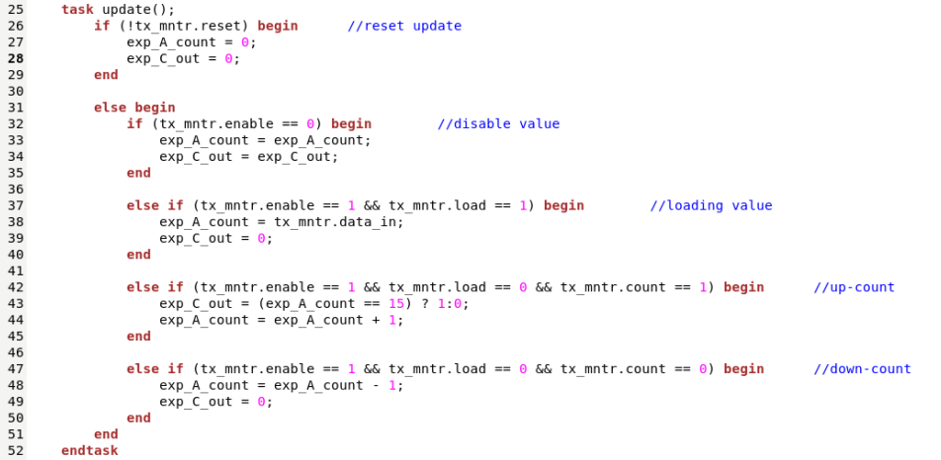
Scoreboard (Cont.)
Here, expected values for A_count and C_out are updated.

Slide 20
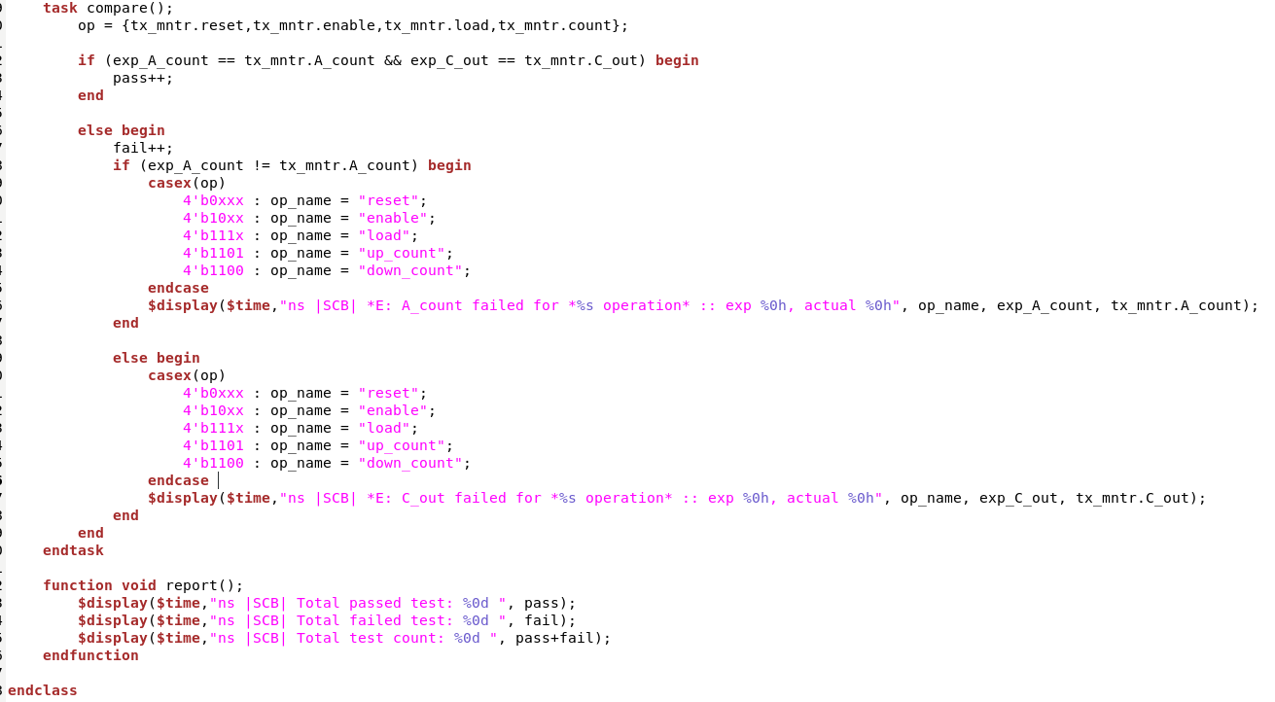
Scoreboard (Cont.)
If expected value for A_count and C_out = actual values, then pass is incremented. Otherwise, fail is incremented and also checks which of the expected values are not equal to the actual values. After comparing all of the values for each test case, a final report is generated.

Slide 21
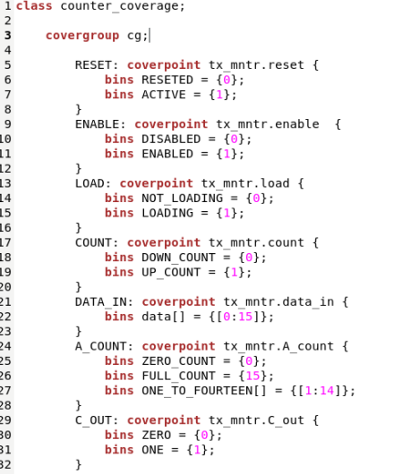
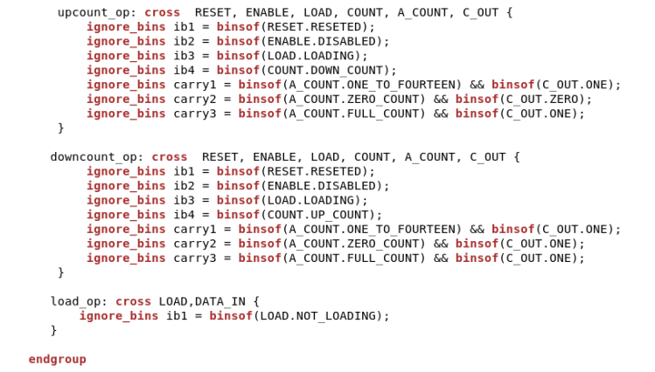
Coverage

Slide 22
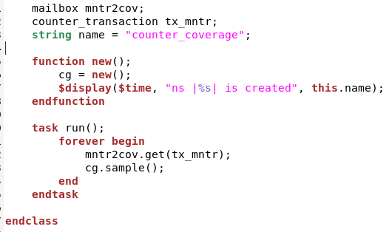
Coverage (cont.)

Slide 23
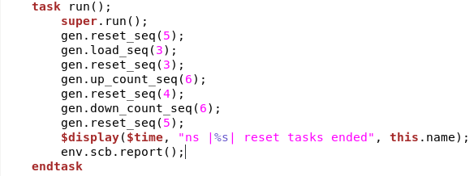
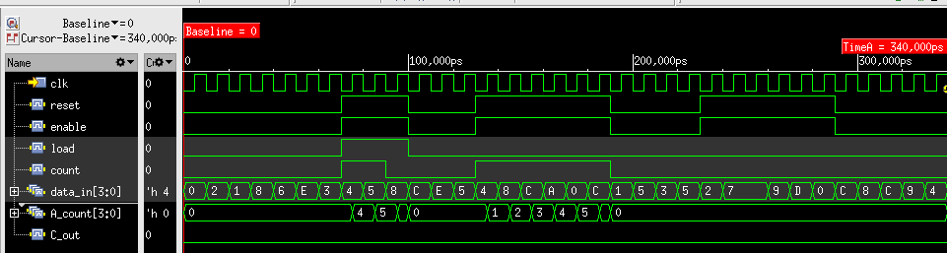
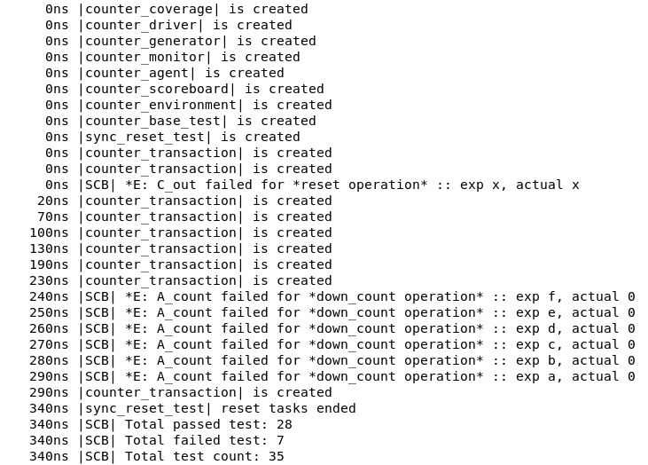
Reset Test
Asynchronous reset
Bug Report: Asynchronous Reset (Both designs)
Whenever reset task is called, A_count gets to 0, like an asynchronous reset.
The design was supposed to have a synchronous reset, which means A_count would be set to 0 at the positive edge of the clock pulse.

Slide 24
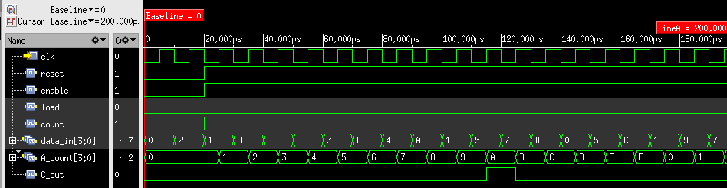
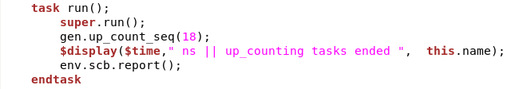
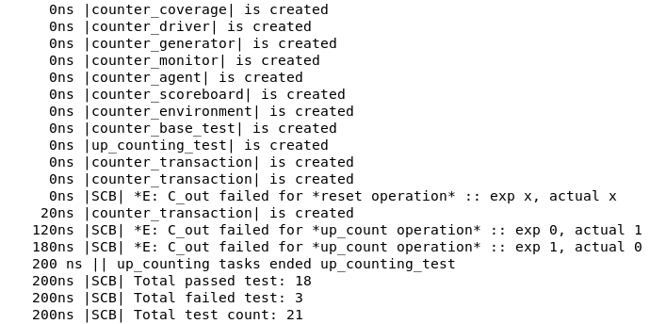
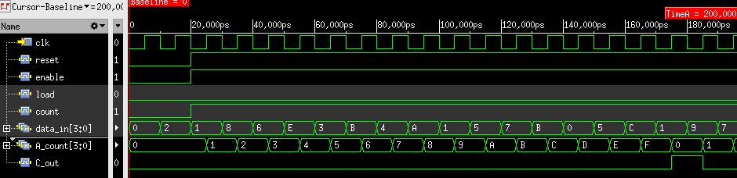
Up Counting Test
Bug Report: C_out value (Previous design)
In case of UP COUNTING, (reset=1, enable=1, load=0 and count = 1), the value of C_out was expected to be 1 after A_count again becomes 0000 after 1111. However, the value of C_out = 0 for that scenario.
On the other hand, C_out becomes 1 when A_count UPCOUNTs to 1010, and on the next cycle, when A_count increments to 1011, C_out again becomes 0. C_out was expected to be 0 in this whole scenario.

Slide 25
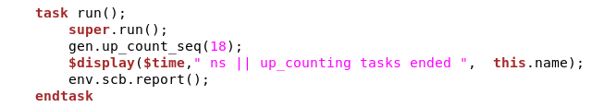
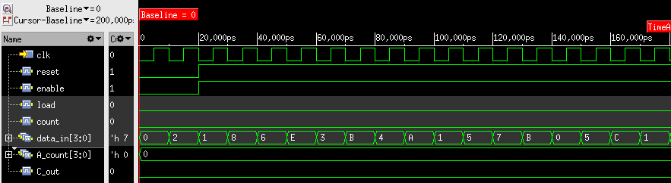
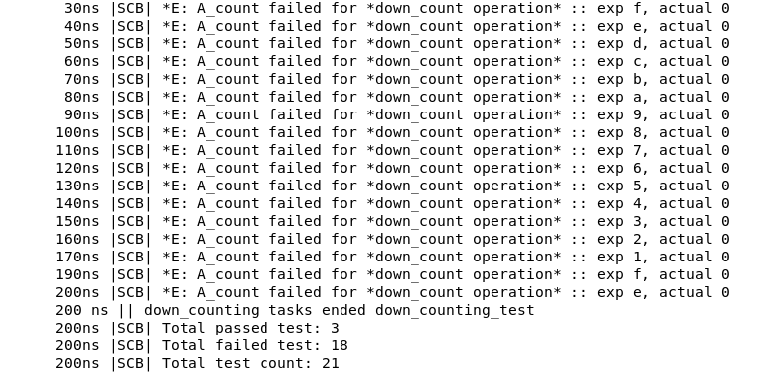
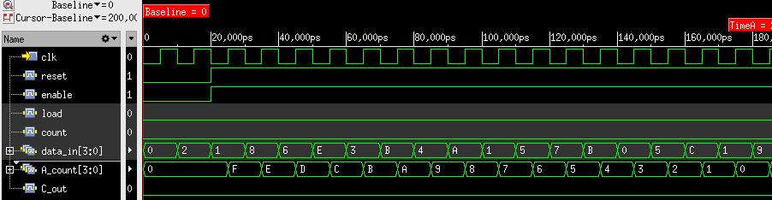
Down Counting Test
Bug Report: Down Counting Operation (Previous design)
When reset=1, enable=1, load=0 and count = 0, A_count was supposed to be counting backwards
However, A_count was holding previous value for the whole period when count = 0
Not operating down counting

Slide 26
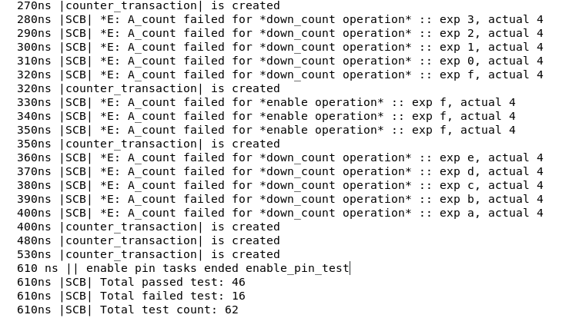
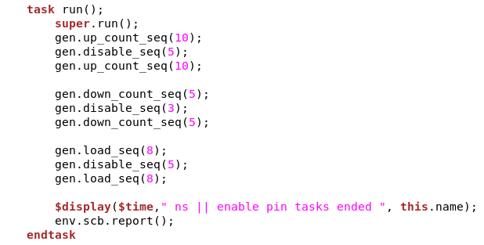
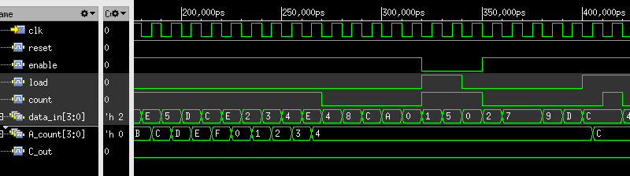
Enable Pin Test

Slide 27
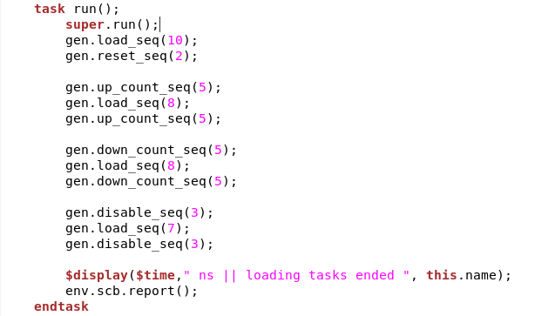
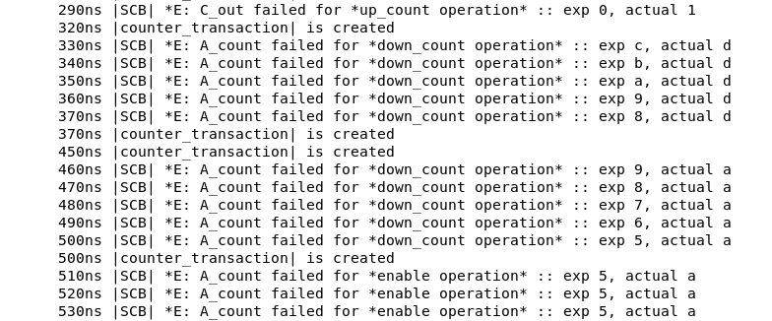
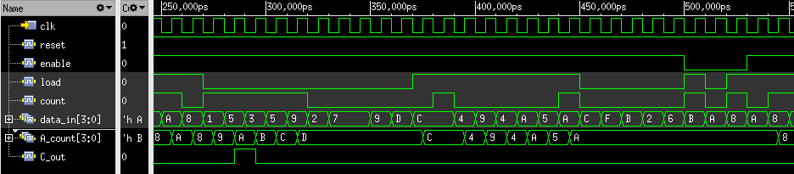
Load Value Test

Slide 28
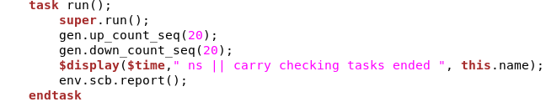
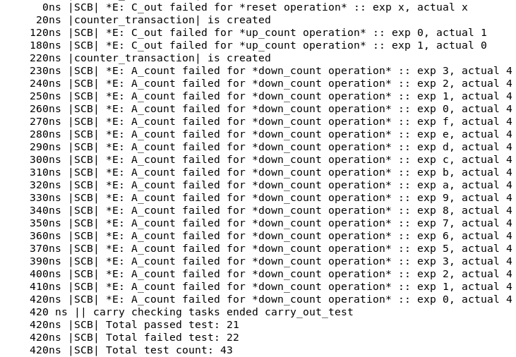
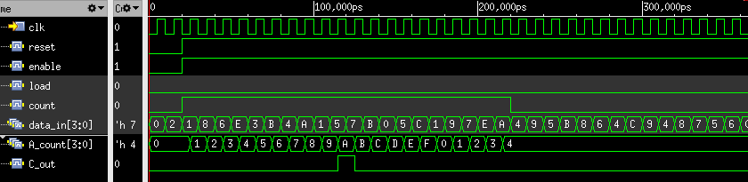
Carry Out Test
Reported bug for C_out on the Up_Counting_test and down counting operation on the Down_Counting_test previously.

Slide 29
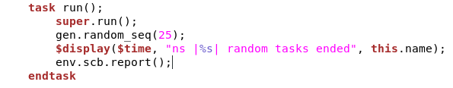
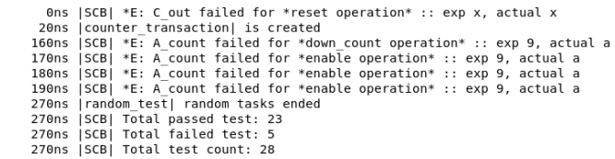

Random Test

Slide 30


Bash Scripts
Run script:
Regression script:

Slide 31


Coverage Report
Overall Coverage:
Covergroup bins:

Slide 32

Coverage Report (cross coverage)
Cross coverage for up counting operation

Slide 33


Coverage Report (cross coverage)
Cross coverage for down counting operation
Cross coverage for load operation

Slide 34
Thank You

